Slide 1
Sharman Oak Hospital Disaster Management Plan
Name:
Institution:
Date:

Slide 2
Hospital Disaster Management
Hospitals have developed various policies and mechanism to deal with disasters?
What are some of these practices related to disaster management?

Slide 3
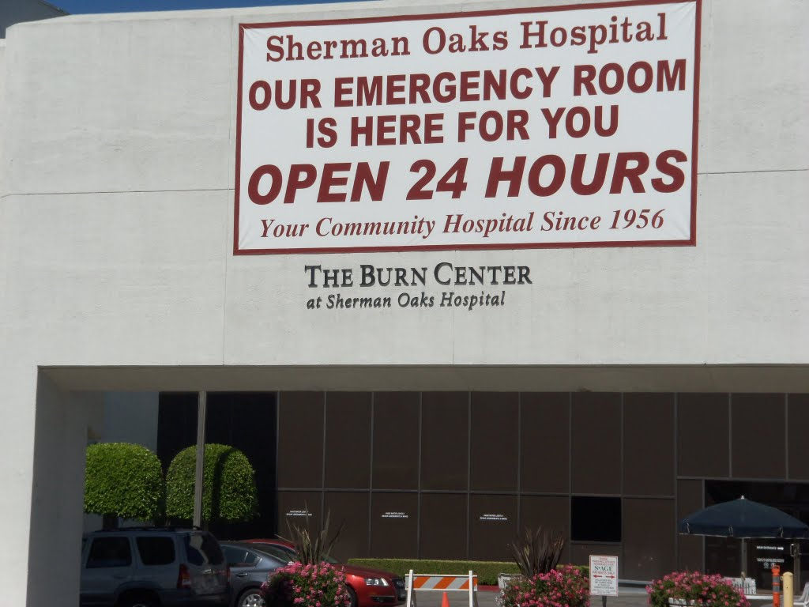
Introduction
Hospitals plans to respond to disasters and emergencies has evolved over the years.
Health facilities are responsible in reviewing and implementing response plans to emergency situations.
Disaster response plans addresses both internal and external disasters.
Health personnel decides on priorities during evacuation.
Notes:
Reviewing and implementing disaster management plans is one of the major roles of health facilities. Many of this response plan are regulated to cover both external and internal disasters. Internal disasters in hospitals include fire, utility dysfunction. External events classifies those that events that cause mass injuries, for example a jumbo jet crash, bomb threats, hurricanes, radiation contamination and all acts of terrorism in a health facility. Sherman Oak hospital has taken bold steps towards ensuring that that its staff is fully prepared for any disaster occurrence (Yi et.al. 2010) The management has taken responsibility to develop mitigation and response plans and also ensure continuous skills upgrade to its staff.

Slide 4
Internal Disaster Triage
All personnel at Sherman Oak hospital have individual roles incase of an internal disaster.
All staff apply critical thinking and triage to respond to various emergencies in the Hospitals.
The hospitals has set guidelines indicating the order of priority, if the internal disaster require relocation or evacuation of clients and staff.
When a fire breaks out in the hospital, the response within a short span of time makes a lot of difference.
Notes:
The Sherman Oak Hospital management understand clearly that how quick they respond to an emergency makes all the difference. Quick response can mitigate an occurrence from becoming catastrophic. Incase of fire outbreaks in the Hospitals. Staff have been equipped with skills and knowledge in the steps they should take in a fire event. Hospital supervisors make sure that the hospital personnel undergo adequate training in the fire response plan procedures. They supervise to ensure that all personnel carry out their duties and follow the set individual instructions. The management has indicate to its personnel that it is the responsibility of every member to report a fire outbreak.

Slide 5
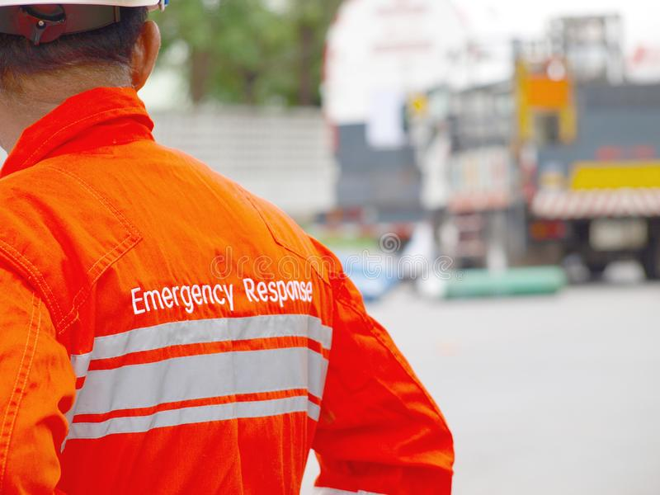
Fire Response
Co-ordinated response and efforts in a fire event can prevent absurd loss of life and property.
Hospitals have made procedures and policies that relates to fire drills.
Staff is equipped with knowledge of what to do in cases of a fire outbreak.
Notes:
Staff members are obligated to rescue, alarm, confine and extinguish fire if it originates around their area. Calmness should be maintained to prevent panic. The hospital staff should remove those patients at risk, report fire outbreak using the switchboard operator and ensure to indicate the location of the fire, type and how large the fire is. When the fire is small it is responsibility of any individual to contain it using an extinguisher to prevent further spread.

Slide 6
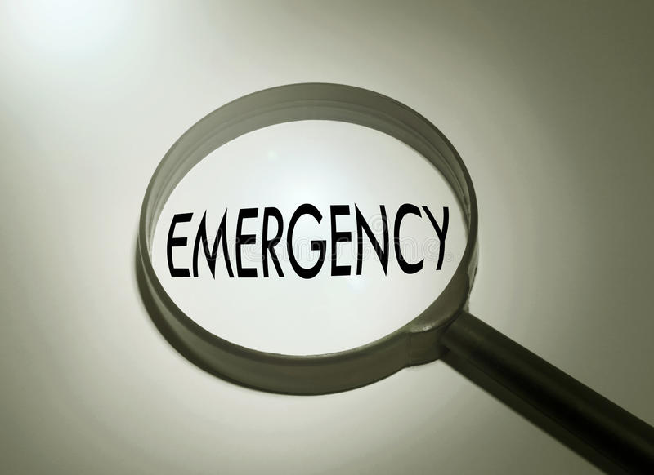
External Disaster plan
External disaster in the community are associated with massive casualties.
External disaster means that the Hospital occupancy would increase.
Unexpected number of disaster victim with different injury severity seek medical attention in the facility.
Medics discharges clients and relocates staff and clinical beds to serve the external disaster causalities.
Notes:
External disasters are characterized by occurrence of multiple casualties in the community that require medical attention. The required materials have to be provided. The material management department takes the role of supplying the required medical equipment. The department makes early procurement of supplies from their in anticipation of prolonged emergencies. This ensure the hospital is fully operational in case of an external disaster in the community. When an external occurs the highest ranking employing becomes the team leader whose first role is to report the disaster occurrence to the hospital command center. He then ensures the following of code triage of external checklist.

Slide 7
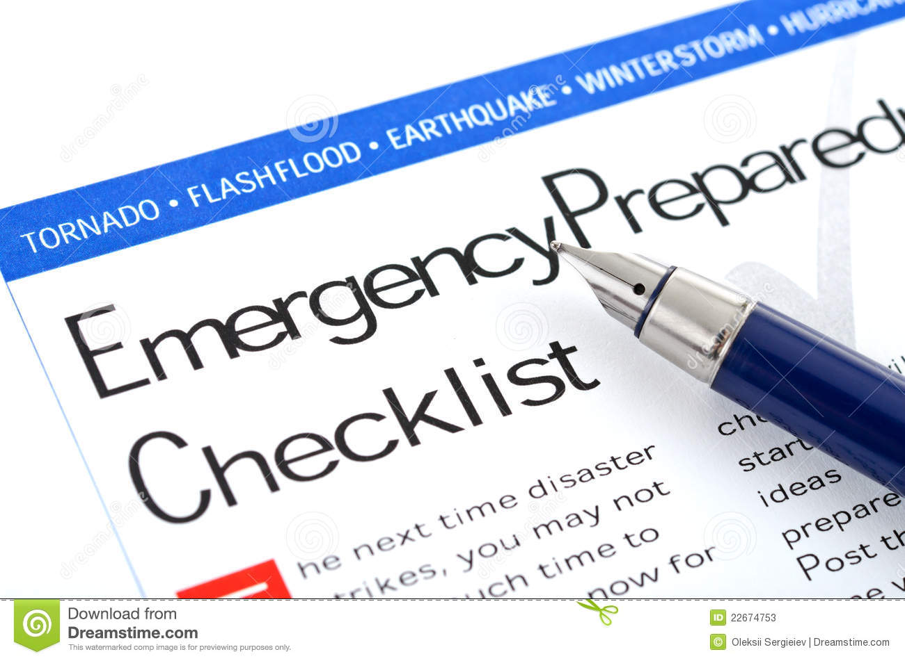
Cont:
When a surge in patients admission is likely to occur, relocation of patients occur in the following descending order:
Unstable clients
Stable clients
Ambulatory clients.
Notes:
Unstable clients are those with the most severe medical condition. Such patients can not be discharged or transferred to another hospital. They are therefore relocated to another clinical zone in the same hospital to create space for incoming disaster patients. Stable clients but still require medical care come second in priority. They are relocated after all patients with low priority are discharged and there is still need for more space or resource reallocation to clients that require most agent medical care. Ambulatory or self care patients are the first to be comfortably discharged, relocated or transferred from the hospital as they require the least medical care.

Slide 8
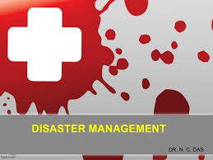
Services Interruptions.
Disaster is never an isolated case nowadays.
Disaster do affect the functionality of health facilities.
Plans have to be instilled to ensure protection of vital health care and patient management functions.
Notes:
Disaster has profound effects on health facility ability to deliver proper health care to the community. Which ever the disaster, health facilities are at risk of losing patient management and crucial healthcare functions. Disaster may devastating impairment of the facilities’ equipment, telecommunication, data, personnel resources. Disaster causes increase in operation cost hence shrinking the facilities’ financial resources. As a result hospital are not in a position to maintain skill upgrade to their employs leading to poor health services. Due to this hospitals should do frequent re-examination of their capability and preparedness (kraiewski etar. 2005) to tackle emergencies in the community. Contracts with both human and physical resources should be made to ensure their availability when they are most needed.

Slide 9
Communications With External Authorities
Communication plan are crucial as:
Facilitate efficient communication after and during a disaster.
Provide guidelines on external crisis communication.
Allows co-ordination and harmonizing staff and authorities in implementation response plan.
Notes:
The importance of communication to external authorities is to prepare the response to a disaster. Also used to clearly and concisely give the information of those affected by the disaster. Disaster communication procedures are incorporated to make sure that emergencies are reported to appropriate external authorities, for example, police, fire brigade, ambulance. Crisis preparation involve continuous communication to identify components needed to prepare for disaster occurrences. In the event of a disaster both external and internally a communication team is responsible in relaying the information to relevant authorities. The team has the current contacts information which it ensure it is up-to-date. Frequent communication with external stakeholders ensure update of information that pertains to disaster preparedness.

Slide 10
Staffing
Sharman Oak hospital should ensure that it has adequate supplies of qualified members of staff to ensure continuity of operations.
Non-clinical and non emergency doctors can be rea-allocated to emergency areas.
Unemployed and retired health providers can be recruited temporarily.
Bridging the public health community and the hospital is crucial.
Notes:
One of the main components of an effective disaster management strategy by a hospital is ensuring that it has an adequate supply of qualified healthcare providers who come from a wide array (Yi et al. 2010). This calls actions like re-allocating the non-clinical and non—emergency doctors to the hospital’s emergency areas to address to address the issue. In addition, the facility should consider recruiting unemployed and retired health providers to offer services on temporally basis. Moreover, during an emergency, the facility should be in a position to bridge the traditional distinction between the public health community and the medical care community (Sherman Oak Hospital) in preparation for any emergency.

Slide 11
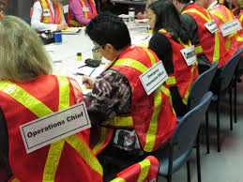
Cont:
Implement a wide range of staff training.
Guarantee protection of workers handling disaster.
Create a contingency plan for essential commodities for staff.
Ensure that there is adequate multidisciplinary psychological support team (Chapman & Arbon, 2008).
Identify the domestic support measures.
Notes:
Implementing adequate training for the hospital staff in preparation for a disaster is required to ensure a successful medical and health intervention of a disaster (Veenema, 2006). Training of staff should include; general disaster response, ethical and legal basis of allocating hospital resources, how to identify symptoms of a certain hazard and how to treat it (Collander et al. 2008). coordination is during an emergency response is critical. Several strategies can help in ensuring protection of the staff addressing the disaster. These strategies may include; prophylaxis, personal protective equipment, adequate back-up for the workers to avoid fatigue, and adequate care and protection of the family of the members of staff. The domestic measures to be addressed may include; childcare, travel, and care for ill family members. Domestic support measures enable the workers to work for long hours and be flexible for shift reassignments. Moreover, the hospital should ensure that there is adequate multidisciplinary psychological support teams which include clergy, counselor, interpreters, and social workers for the families of the patients and staff. Last, Sharman Oak Hospital should establish a contingency plan to provide the members of staff with water, living places, and water.

Slide 12
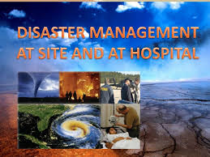
Departmental Assignments
Various departments will be responsible for addressing disaster in the hospital.
Administration
Transportation.
Emergency department
Operating room
Notes:
An event or a disaster may exceed the resources of one department in a hospital facility or have operational impacts on various departments. The different departments that may be involved in disaster management carry out resource and personnel assessment and send information to the emergency operations center. The administration is responsible for directing the response to the disaster and overseeing disaster management in the hospital. Moreover, it is the duty of the hospital administration to design and implement an emergency training course for the members of staff. Also, the administration coordinates various departments through communication and even with the outside authorities like the government.
During disaster response the transportation department is important. It helps in providing transportation services for the relief operations. In addition, it is responsible for boasting the evacuation operations during the disaster. Also, it is used in transporting food and other essential commodities to the incident.
The emergency department in the hospital acts as the interface between the inpatient and outpatient care. It has advanced treatment and diagnostic technologies which are rare in the doctor’s offices. Moreover, this department is staffed by highly trained nurses and physicians to manage disaster problems in 24 hours a day and seven days a week basis.
The operation room is responsible for monitoring the situation of the disaster and taking the necessary procedures to implement the national response plans. Moreover, it keeps that database of the national resources, and manage it during emergencies and crisis.

Slide 13
Cont:
Other departments that will deal with the issues of disaster management in the hospital include;
Respiratory care
Facilities engineering.
Nursing.
Security
Notes:
The security department is responsible for offering security services for the patients and members of staff involved the in the disaster management. Moreover, the security personnel help in preventing people from accessing the incident area which may cause increased number of victims or reduce the productivity of staff to rescue
More people. Laboratory service department is responsible for preparing emergency plans and incorporating them in to the general disaster plan of the healthcare sector. It has both ethical and legal responsibilities to its staff and patients during a disaster. The responsibilities include protection, service, and the ability to make a quick recovery from a disaster. This is achieved through careful planning, preparation, and testing of the plan. The facilities engineering department is responsible for designing and implementation of a cost-effective and efficient operation of the hospital facility. The department ensures that the physical plant of the organization is running smoothly. They ensure that systems are working normally and increase the lifespan of the newly remodeled or constructed facilities. Nurses in the nursing department remain to be largest group of healthcare providers for disaster preparedness, active response, and recovery (Chapman & Arbon, 2008). They play the key service provision and leadership role in both planning and implementing efforts of disaster response, curbing any technological disasters, and dealing with any issues that may arise during disaster. Such issues may include emotional and physical distress of patients (Chapman & Arbon, 2008).

Slide 14
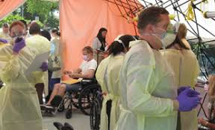
Decontamination (Chemical And Radiation)
Confirm that the decontamination teams are ready.
Carry out a triage.
Undress the casualty while ensuring privacy
Basic life support.
Wash from head to toes using soap water, and then rinse.
Notes:
Prior to decontamination process, the decontamination team should be ready with personal protective equipment to ensure that they are not affected by the chemicals or radiation. Failure to this, the staff may be affected hence reducing the overall effectiveness of the team. Casualties of chemical and radiations incidents may arrive tagged. The first this should be carrying out a triage, which involves considering the number of victims who need urgent decontamination. This should be done using the right guidelines. Basic life support should also be delivered in the decontamination areas. Doing this effectively will help in managing the airway, stabilizing cervical spine, arresting hemorrhaging, and predetermining the required emergency measures which will be used during the process of decontamination. The casualty should then be undressed while ensuring privacy. The casualty should be decontaminated as soon as possible by removing his/her clothes from top to bottom. Casualties’ underwear should be left on for privacy purposes or provide a cover for the private areas if the underwear is removed.

Slide 15
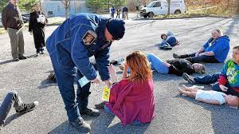
Cont:
Double bagging and securing clothing, and effects
Tag valuable and belongings.
Consider the patients with special needs.
Monitor the staff in PPE.
Wash from head to toes using soap water, and then rinse.
Notes:
Double bagging and securing clothing, and effects is important to maintain a forensic evidence and a chain of custody for the belongings. The patients should be in a position to trace and receive their personal belongings. The valuable and belongings should be tagged. The belongings should include the names of the casualties if they are known. If they are not known, individual sequential numbers should be allocated. Sherman Oak hospital should develop a contingency plan for special needs patients. Mothers and children should be decontaminated first since they are more likely to become traumatized and are susceptible to chemical and radiation uptake through the skin especially small children. Washing the casualties from head to toes using soap water, and then rinsing is important. water flushing is often regarded as the best way of decontaminating a casualty. The washing should be done from top to down using soap and a soft cloth.

Slide 16
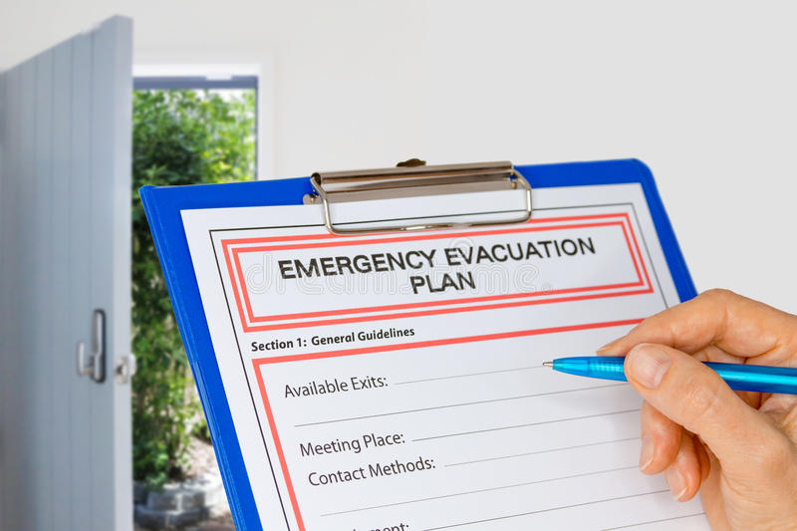
Evacuation Plan And Routes
Incase of any emergency, the steps that should be taken include;
Rescue
Alarm
Confine
Extinguish
Notes:
When an emergency like fire strikes a hospital facility, the actions that are taken during the first few seconds or minutes are very crucial, they make a difference between containment of the emergency or a catastrophe. The disaster response plan has the responsibility to provide the hospital personnel with the skills and knowledge of dealing with the event (Wattanawaitunechai et al. 2005). If an emergency is experience, the first step should be rescuing the patients first. Any person within the immediate danger should be removed to a safer area. The second step is reporting the emergency. In case of fire, the wall fire alarm should be pulled. The switchboard operator should then be notified to the area of emergency, specific location, type of disaster, and the extent of the emergency. The third stage is containing the emergency., if possible. Incase of fire, one can close the adjacent windows and doors. The last step is returning to the scene of emergency to end it. incase of fire, then ABC fire extinguisher should be used.

Slide 17
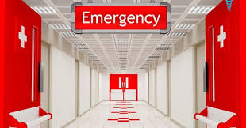
Evacuation Route
Patients will be moved through the corridors horizontally on the floor.
Elevator will not be used.
patients will be gathered in the Nurse Stations\ in the second and third floor.
On the first floor,, patients will assemble in the Lobby or Parking lot.
For vertical evacuations, the patients will move from the nurse station through the stairway.
Notes:
the patients should be moved first from the hospital incase of a disaster. They should be moved horizontally using the corridor through the doors to the emergency free location s within the same building and floor. The elevators should not be used as a way of evacuating the patients. All the evacuations that are vertical should be through the stairways under strict supervision of an emergency response team. On the second and third floors of the facility, the patients should gather in the nurse station while those on the first floor assemble in the lobby or the parking lot. All medical record charts of the patients should be removed. During the evacuation process.

Slide 18
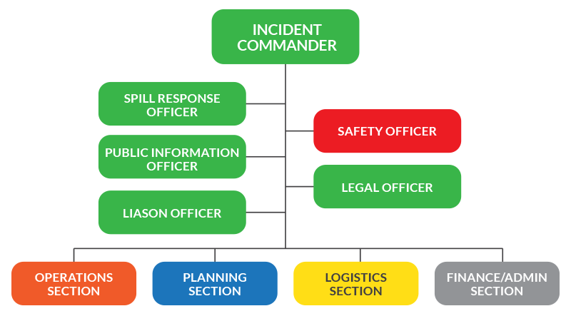
Hospital Emergency Incident Command System (HEICS)

Slide 19

What do HEICS refer to?
It addresses “all hazards” in a structural command.
It is also a link with other outside sources.

Slide 20
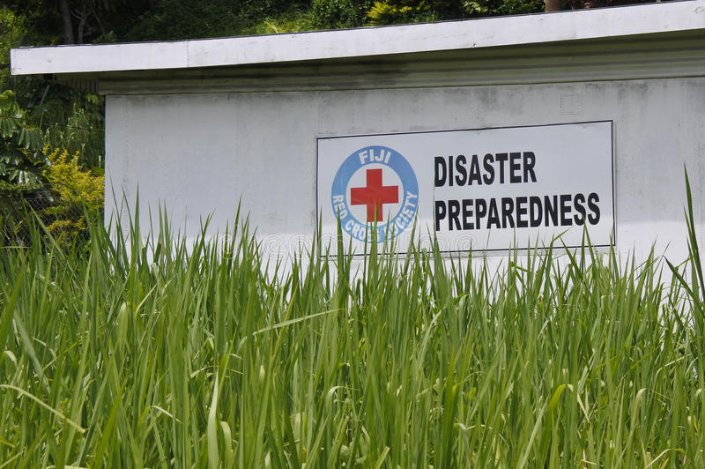
HEICS is important because…
It provides a dependable chain of command
Improves communication among those involved
It is flexible
Sets priority of tasks
It is effective

Slide 21
References
Yi, P., George, S. K., Paul, J. A., & Lin, L. (2010). Hospital capacity planning for disaster emergency management. Socio-Economic Planning Sciences, 44(3), 151-160.
Wattanawaitunechai, C., Peacock, S. J., & Jitpratoom, P. (2005). Tsunami in Thailand—disaster management in a district hospital. New England Journal of Medicine, 352(10), 962-964.
Chapman, K., & Arbon, P. (2008). Are nurses ready?: Disaster preparedness in the acute setting. Australasian Emergency Nursing Journal, 11(3), 135-144.
Collander, B., Green, B., Millo, Y., Shamloo, C., Donnellan, J., & DeAtley, C. (2008). Development of an “all-hazards” hospital disaster preparedness training course utilizing multi-modality teaching. Prehospital and disaster medicine, 23(1), 63-67.
Krajewski, M. J., Sztajnkrycer, M. D., & Baez, A. A. (2005). Hospital disaster preparedness in the United States: new issues, new challenges.
Veenema, T. G. (2006). Expanding educational opportunities in disaster response and emergency preparedness for nurses. Nursing Education Perspectives, 27(2), 93-99.

